Slide 1
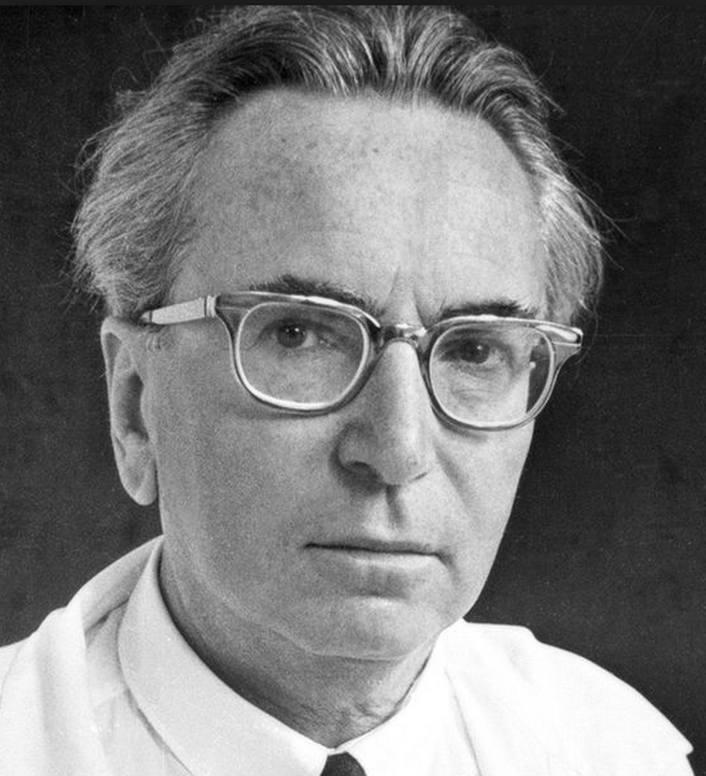
Victor Frankl and his existential logotherapy
Batarin Egor, DREC MIPT, 3rd year
https://kafedrapsihologii.ru/wp-content/uploads/2018/12/Screen-Shot-2015-04-29-at-8.21.50-AM.png

Slide 2

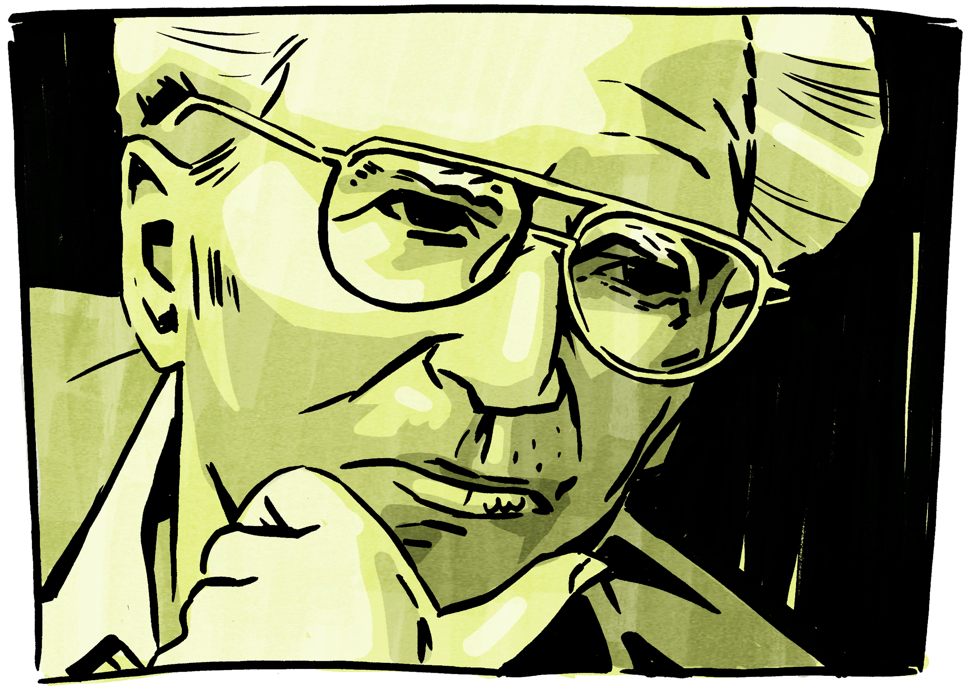
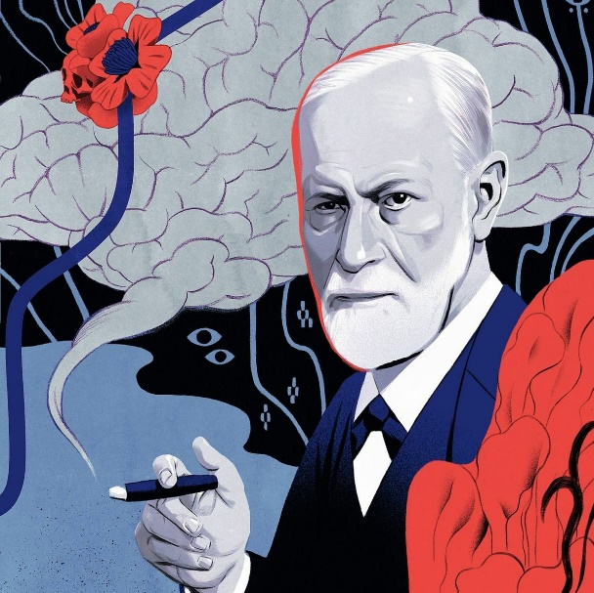
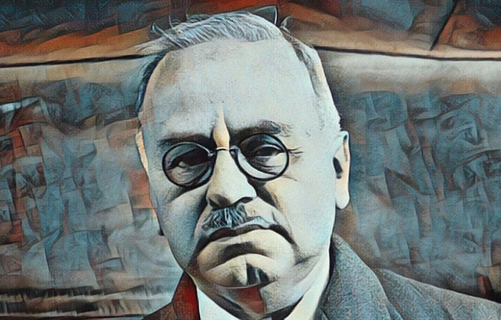
https://happytravel.bestclub.travel/cab/images/Венгрия_флаг.png
V. Frankl
S. Freud
A. Adler
https://i2.wp.com/video-images.vice.com/_uncategorized/1496329594203-2-Best-2-20.jpeg?crop=12
https://www.menteasombrosa.com/wp-content/uploads/2019/05/alfred-adler.jpg
https://pbs.twimg.com/media/D1YdxM6WwAAAH7x.jpg

Slide 3
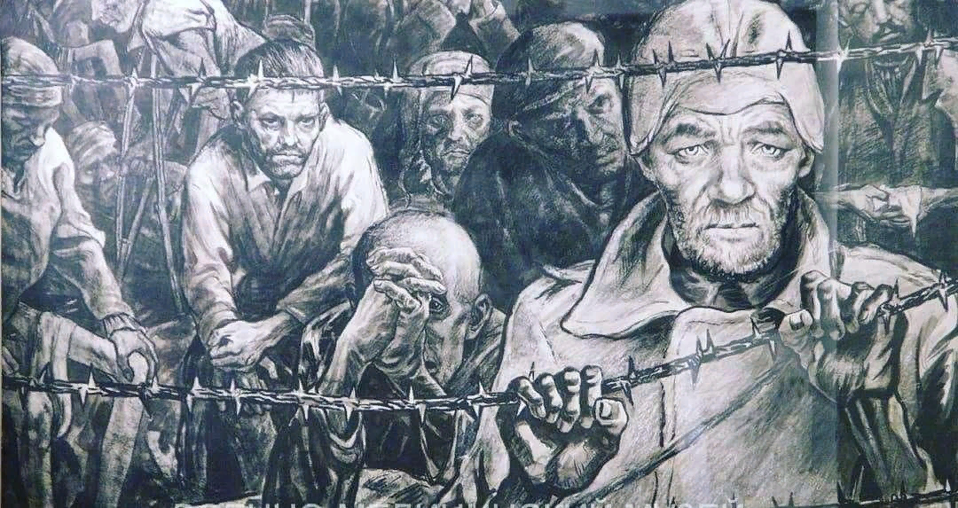
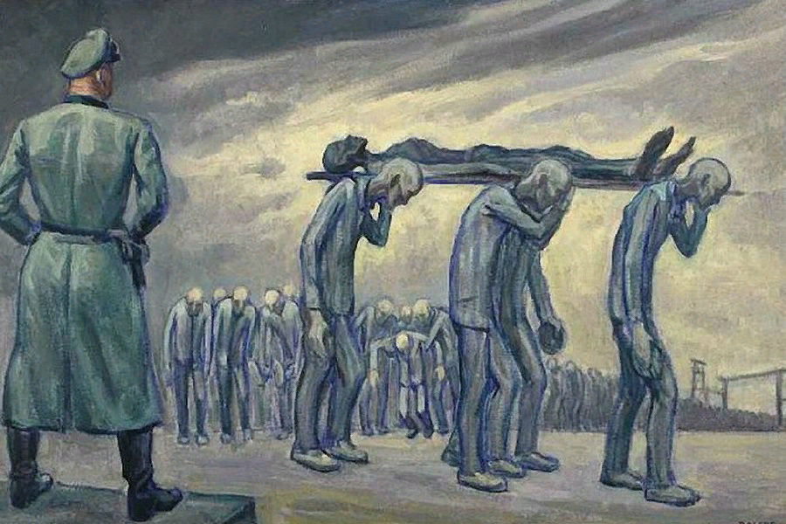
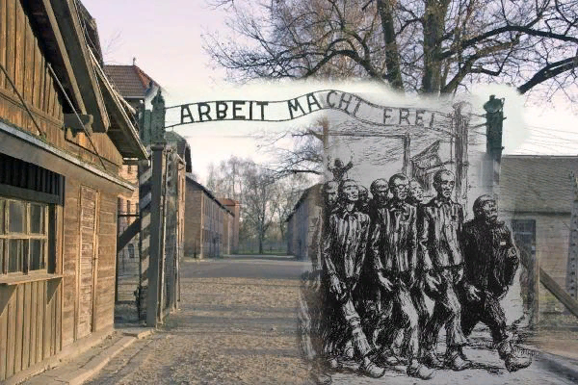
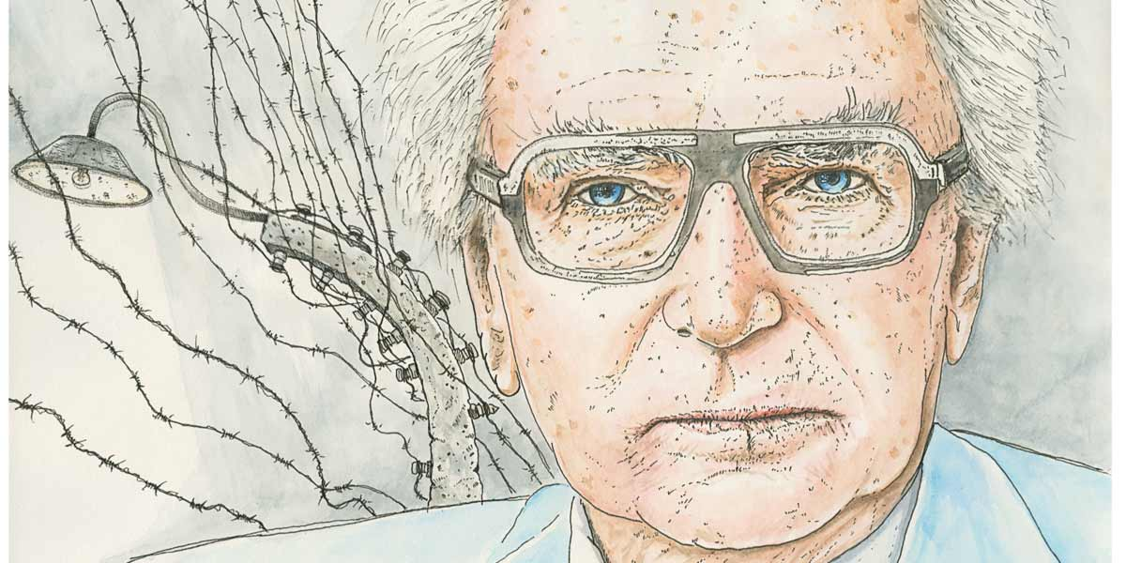
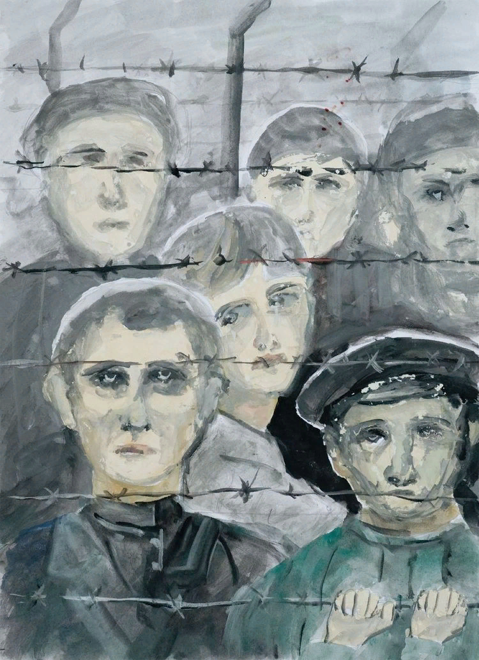
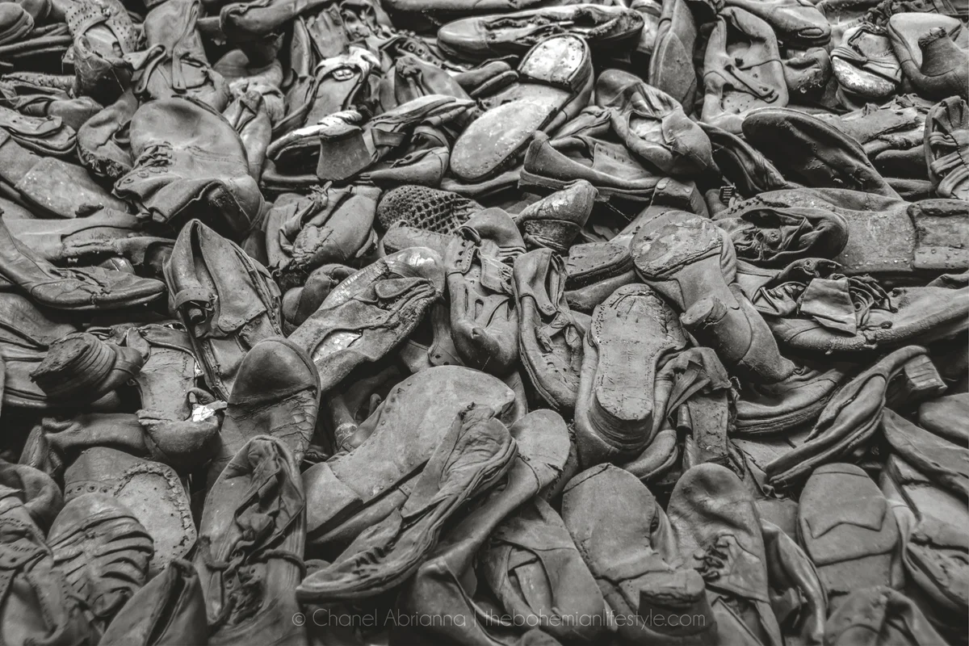
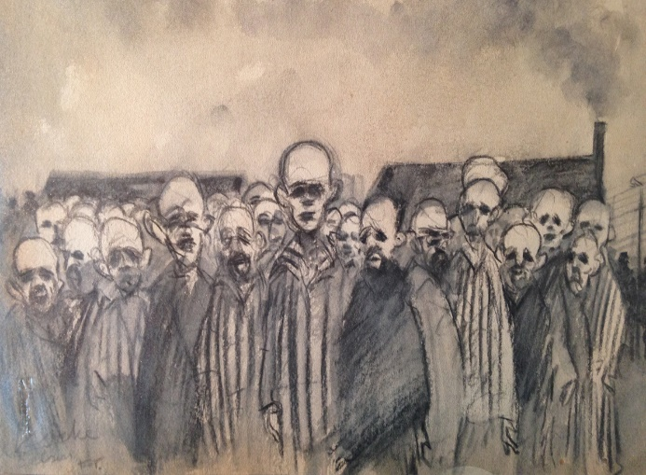
https://mtdata.ru/u30/photo3164/20358695251-0/original.jpg
http://litavrora.ru/media/k2/items/cache/e17c186eb9077cbeac8526f7738e2917_XL.jpg
https://www.culture.ru/storage/images/9f9430125f868bbdc153d17856f8bd9d/6e2f06af5ac14c4377d2a08e0b96765a.jpeg
https://avatars.mds.yandex.net/get-zen_doc/1652143/pub_5d7f43166d29c13cef8ccc86_5d7f44352f1e4400ad0a7ff2/scale_1200
https://www.townhousespitalfields.com/wp-content/uploads/2016/04/Drawing-of-Belsen-concentration-camp-by-Feliks-Topolski-1945.jpg
https://www.plough.com/-/media/images/plough/quarterly/2018/15wintertech/15landsel/15landselfranklsocial.jpg
https://ost-arbeiter.com/wp-content/uploads/2017/01/DSC_0118.jpg

Slide 4




Logotherapy principles
https://anons.uz/media/uploads/2020/12/05/917809-1519845051.jpg
https://i1.wp.com/adella.ru/wp-content/uploads/2018/01/4145-min.jpg
https://catherineasquithgallery.com/uploads/posts/2021-03/1614586783_5-p-trava-na-belom-fone-11.png

Slide 5

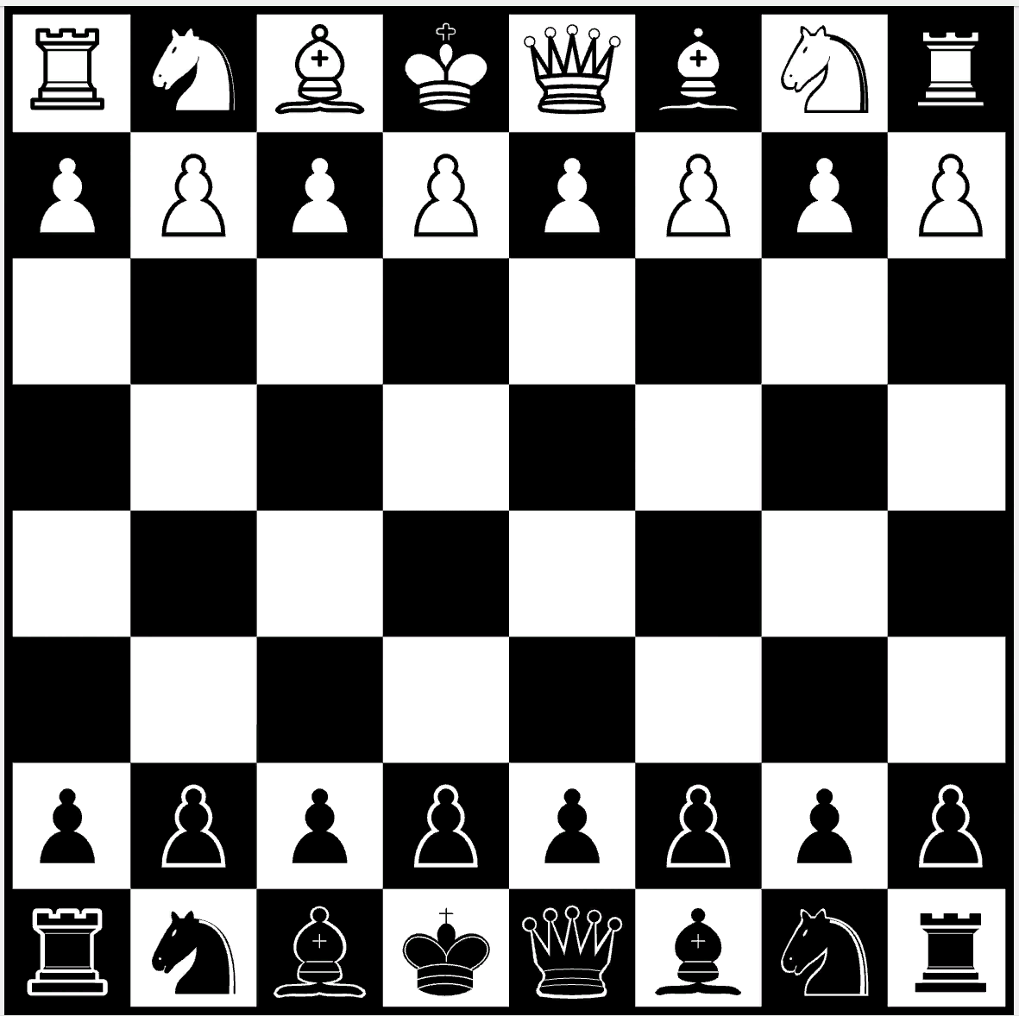
The meaning of life
https://images.chesscomfiles.com/uploads/v1/user/19271306.e49467af.1200x1200o.c880873d1360.png

Slide 6
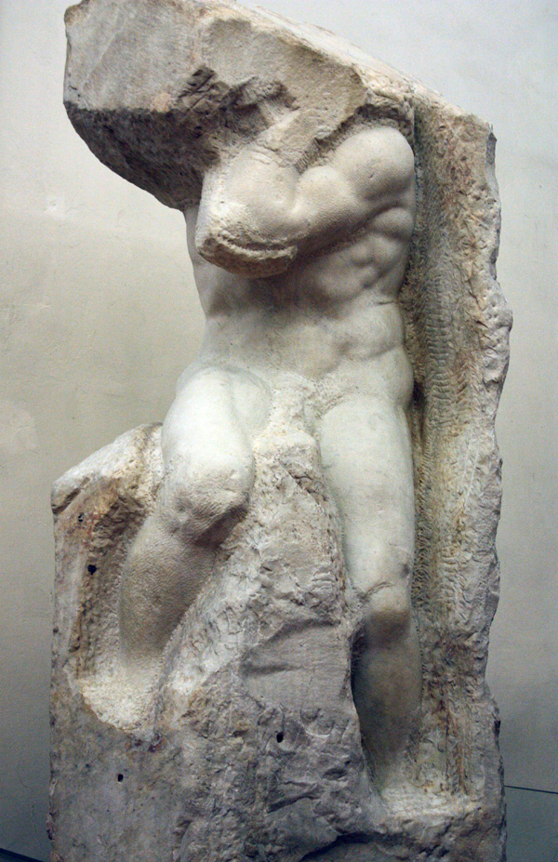

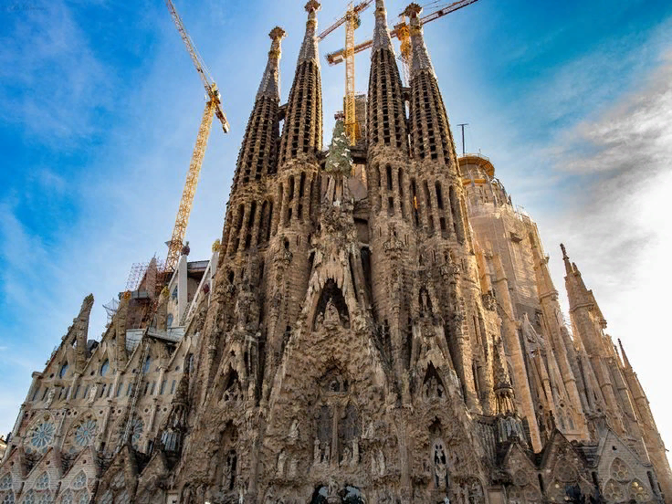
The meaning of death

Slide 7

The meaning of love

Slide 8



For further reading…

